Slide 1
Sales Predictions
By: Spencer Reno

Slide 2
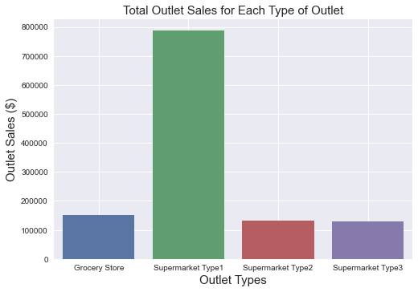
This first graph is comparing the total sales for each outlet. In this graph its clear that supermarket type 1 has made the most out of the four. However, the other three all are around 100,000-200,000 dollars.

Slide 3
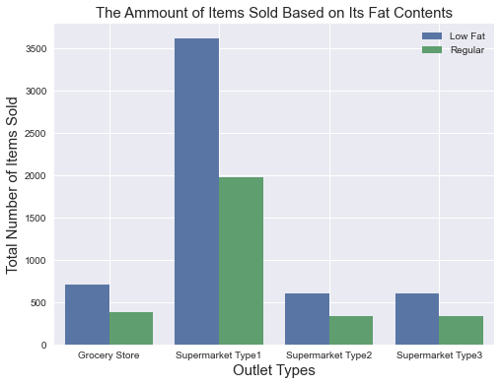
Next, we’ll take a look at the number of items sold by each outlet based on their fat contents. Based on the first graph we know that supermarket type 1 made the most in sales so here its only right that they also sold the most items. As well, we can see that across the board every outlet did better at selling low fat items over regular items.

Slide 4
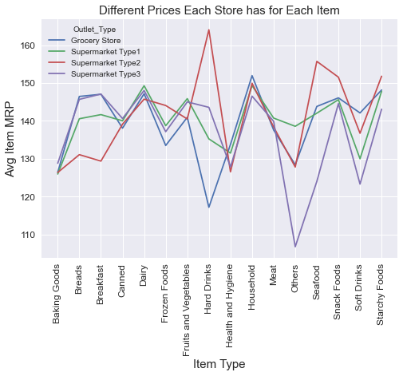
Now that we’ve compared all the different outlets with how they did on their sales. Let's look at how their average prices for each item match up against each other. Here if we specifically look at supermarket type 1 to see why they do so well. Its clear they stay right in the middle of all the stores with none of their prices going to high. Although they might not have the lowest prices on some items since they don’t have the highest, and are more in the middle it’s a great one stop shop for every item.

Slide 5
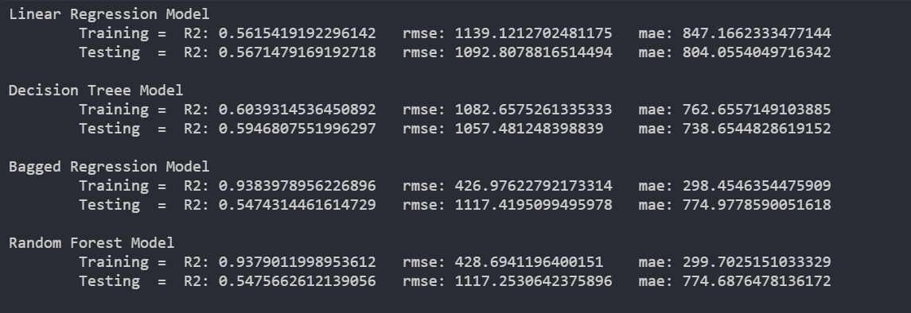
Now looking at our machine learning models here are all the training and test results from each model and their r2 scores, rmse, and mae. Looking at the four models none of them really performed to well. So, I did some research based on the dataset and found that going to the site that the data was obtained from there are other submissions based on this dataset.

Slide 6
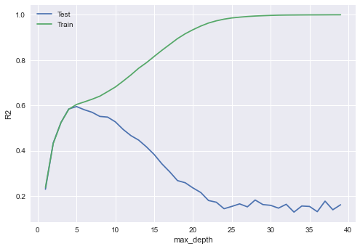
Here in this graph shows the r2 score split between the test and train data based on the max depth parameter for the decision tree model. The train line as shown splits apart from the test after an r2 score of .6 based on how high you go with the max depth.

Slide 7
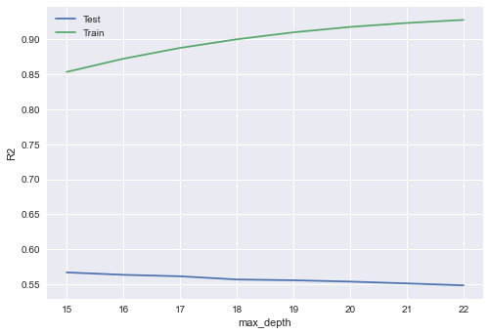
Similarly, the graph above this shows the separation for the random forest model. However, with this graph, it's a little different. To get a better test score you have to have a higher max depth parameter. So here starts at 15 and ends at 22 the lines never come close like the other graph.

Slide 8
Final Thoughts

